Slide 1

CHAPTER 7 Big Data, Reporting, and Analytics Services in Azure
|LEARNING MICROSOFT AZURE

Slide 2
Big Data
Overview of Big Data:
The exponential growth of data in recent years
Shift from traditional analytics to cloud-based solutions
“Data is the new oil” – emphasizing its value in business strategy
Objective:
Understand the impact of big data analytics in driving informed business decisions.
What is Big Data?
Definition and Characteristics:
Volume: Scale of data (terabytes to petabytes)
Variety: Diverse data types (structured, semi-structured, unstructured)
Velocity: Speed of data processing (real-time analytics)
Veracity: Trustworthiness and quality of data
Examples of Big Data Use Cases:
Social media sentiment analysis
IoT sensor data for predictive maintenance
Gaming analytics for user engagement

Slide 3
Big Data
The Need for Big Data Analytics:
Impact of Data on Decision Making:
Evidence-Based Decisions: How analytics help mitigate risks and uncover opportunities.
Data-Driven Strategies: Creating competitive advantages through insights.
Big Data Solutions in Azure
Cloud Services for Big Data:
Azure Synapse Analytics: Integrating big data and data warehousing.
Azure Databricks: Collaborative Apache Spark-based analytics service.
Managed Services:
How Azure simplifies deployment, scaling, and maintenance of big data solutions.
Real-Time Analytics:
Capabilities for processing data streams in real time.

Slide 4
Azure Data & Analytics Services
Azure Database Options
Databases Available in Azure:
Azure SQL Database: Fully managed relational database with scalability.
Azure Cosmos DB: Multi-model database for global distribution and horizontal scalability.
PostgreSQL/MySQL: Open-source databases available as managed services.
Key Features:
Elasticity: Scale up/down as needed.
High Availability: Built-in disaster recovery and backup solutions.
Security: Advanced threat protection and encryption.
Azure Analytics Services
Analytics Products:
Azure HDInsight: Cloud-based service for big data analytics using Hadoop and Spark.
Azure Analysis Services: Provides enterprise-grade analytical data models.
Capabilities:
Generate dashboards and reports with real-time data insights.
Integration with Power BI for advanced visualization.
Data Engineering in Azure
Key Services:
Azure Data Factory: Data integration service for creating ETL and ELT workflows.
Azure Data Lake Storage: Scalable data repository for big data analytics.
Functionality:
Building complex data pipelines to ingest, prepare, and transform data from various sources.
Support for both batch and streaming data.

Slide 5
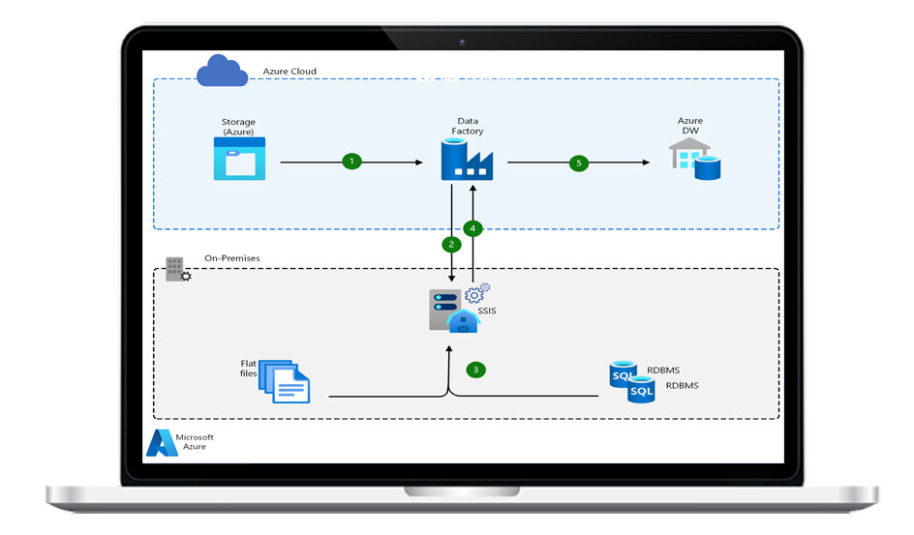
Complex Data Pipeline Tools
Azure Data Factory:
Extract, Load, Transform (ELT): Capabilities for data movement and transformation.
Automation and Scheduling: Set triggers to run workflows on demand or at scheduled intervals.
Real-World Example:
Use case of a retail company analyzing sales data from multiple sources for inventory management.

Slide 6
Designing Big Data Solutions
Four-Step Process:
Evaluation: Assessing business requirements and data sources.
Architecture: Designing a scalable and flexible architecture.
Configuration: Setting up Azure resources to meet the design.
Production: Deploying and monitoring the solution.
Importance of Understanding Data Needs:
Aligning technology with business objectives to drive value.

Slide 7
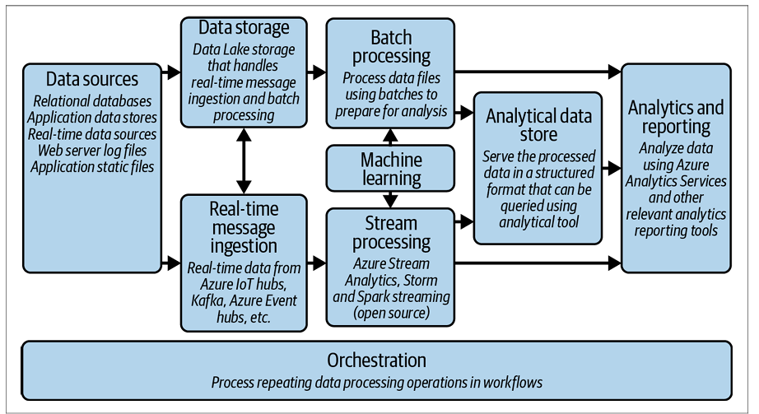
Identifying Big Data Architecture
Categories of Architecture:
Data Volume: Strategies for managing large datasets.
Velocity: Approaches for real-time processing and analytics.
Variety: Handling different data formats and sources.
Sources: Integrating data from IoT, social media, transactional databases, etc.
Implications for System Design:
Balancing performance, cost, and scalability.

Slide 8
Big Data Architecture in Azure
Introduction: Azure provides a comprehensive architecture for handling large volumes of data from diverse sources, enabling businesses to derive insights and make informed decisions.
Key Components:
Data Sources: Various sources including IoT devices, social media, and enterprise applications.
Data Storage: Scalable storage solutions like Azure Data Lake for unstructured data.
Real-time Ingestion: Tools for real-time data collection from multiple streams.
Batch Processing: Frameworks like Hadoop for processing large datasets.
Stream Processing: Azure Stream Analytics for real-time analytics.
Machine Learning: Integrating ML models to enhance data insights.
Reporting: Visualization tools like Power BI for reporting and dashboards.

Slide 9
Benefits of Azure Big Data Services
Managed Services: Azure provides several managed services that minimize infrastructure management overhead, allowing teams to focus on data and analytics.
Azure Data Lake Store: Scalable and secure data storage.
Azure Synapse Analytics: Integrated analytics service.
Azure Stream Analytics: Real-time data processing service.
Azure Data Factory: Data integration service for ETL processes.
Azure Event Hub: Big data streaming platform.
Azure IoT Hub: Solution for connecting IoT devices.
Open Source Technologies: Azure supports numerous open-source frameworks, allowing developers to leverage existing skills and technologies.

Slide 10
Azure Data Lake
Description: Azure Data Lake is a highly scalable and secure cloud storage solution designed to store massive amounts of unstructured data.
Key Features:
Enterprise-grade security: Ensures data privacy with encryption, authentication, and role-based access control.
Native format data storage: Supports various data formats (JSON, CSV, Parquet, etc.) without requiring pre-processing.
Integration with Hadoop and Spark: Seamlessly works with big data frameworks for analytics and processing.

Slide 11
NoSQL Databases in Azure
Overview: NoSQL databases are designed to handle large volumes of unstructured or semi-structured data, providing flexibility and scalability.
Supported Databases:
Azure Cosmos DB: Globally distributed, multi-model database service for high availability and low latency.
HBase on HDInsight: Open-source NoSQL database that runs on Hadoop for storing and processing big data.
Azure Data Explorer: Fast and highly scalable data exploration service for analyzing large amounts of structured and semi-structured data.

Slide 12
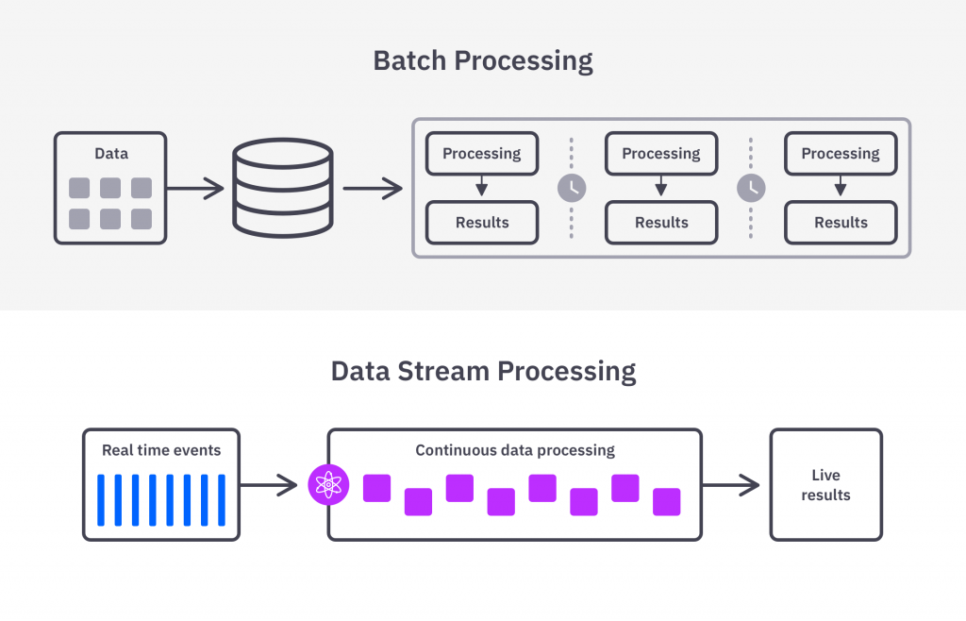
Real-time Stream Processing with Azure Stream Analytics
Functionality: Azure Stream Analytics enables the analysis of real-time data streams from various sources, allowing for timely decision-making.
Key Use Cases:
IoT Monitoring: Real-time analytics for connected devices to monitor performance and detect anomalies.
Web Logs: Analyze web traffic and user behavior for immediate insights.
Point of Sale (POS) Systems: Real-time transaction monitoring for fraud detection and inventory management.
Machine Learning Integration: Enhances analytics capabilities by applying machine learning models to streaming data.

Slide 13
Unified Analytics with Azure Synapse
Description: Azure Synapse is an integrated analytics service that combines big data and data warehousing into a unified experience.
Features:
SQL and Spark integration: Allows users to run queries using either T-SQL or Spark for data processing.
T-SQL queries for data visualization: Facilitates easy querying of data for reporting and visualization.
Serverless and dedicated options: Flexibility to choose between serverless on-demand and provisioned resources.

Slide 14
Collaborative Analytics with Azure Databricks
Overview: Azure Databricks is a collaborative Apache Spark-based analytics platform designed for data science and data engineering.
Key Benefits:
Collaborative workspace: Provides an interactive environment for data scientists and engineers to work together.
Managed Spark clusters: Automatic management of Spark clusters for efficient resource allocation.
Support for multiple languages: Supports Python, R, Scala, and SQL for diverse data processing tasks.

Slide 15
Managed Analytics with Azure HDInsight
Description: Azure HDInsight is a fully managed service for running open-source frameworks such as Apache Hadoop and Spark in the cloud.
Capabilities:
Create and scale data clusters: Easily deploy and manage clusters for big data processing.
Integration with Azure services: Seamless integration with Azure Data Lake Storage and Azure Data Factory for data ingestion and storage.
Support for various frameworks: Includes support for frameworks like Spark, Hive, and Kafka for diverse big data processing needs.

Slide 16
Data Integration with Azure Data Factory
Functionality: Azure Data Factory is a cloud-based data integration service that allows users to create, schedule, and manage data workflows.
Integration Capabilities:
ETL processes: Extract, Transform, Load data from various sources (SQL Server, NoSQL databases, flat files, etc.).
Support for real-time data streaming: Ability to ingest and process data in real-time.
Data orchestration: Automate workflows and monitor data pipelines effectively.

Slide 17
Azure Analysis Services : Enterprise-Grade Data Modeling
Overview: Azure Analysis Services is a cloud-based analytics engine designed for enterprise-grade business intelligence solutions.
Key Features:
High-performance BI solutions: Enables organizations to create complex data models for analytics.
Autoscaling capabilities: Automatically adjusts resources based on workload, optimizing costs and performance.
Integration with Power BI: Seamless integration for creating rich visualizations and reports.

Slide 18
Enhancing Applications with Power BI
Overview: Power BI enables organizations to visualize data and share insights across the organization and embed them in applications.
Embedding Options:
HTML iframe: Easily embed interactive Power BI reports in web applications.
REST APIs and SDKs: Provides extensive APIs for embedding capabilities across various platforms.
Custom Visuals: Support for custom visuals to tailor reports to specific business needs.

Slide 19
Real-World Use Cases of Azure Big Data Services
Retail Analytics: Analyze customer behavior and inventory levels to optimize stock and enhance customer experience.
IoT Solutions: Monitor and analyze data from IoT devices for predictive maintenance and operational efficiency.
Healthcare: Use big data analytics for patient monitoring and improving treatment outcomes.
Financial Services: Fraud detection and risk assessment through real-time analytics of transaction data.

